Slide 1


SOCIETE GENERALE
VERITAS VOLUME MANAGER

Slide 2

OVERVIEW
Fundamentals
Introduction
Virtual Objects
Installation & Interfaces
Managing Disk & Disk groups
Creating Volumes
Configuring Volumes
Administering File systems
Maintenance
Introduction
Managing Devices within the VxVM architecture
Resolving Disk problems
Resolving Plex problems
Recovery Essentials
Encapsulation & Rootability
Troubleshooting & Boot process
Volume Maintenance
Monitoring performance
Point-in-Time copies – Standard & Enterprise
Transferring data for Operational Efficiency
Other Enterprise Features Overview

Slide 3
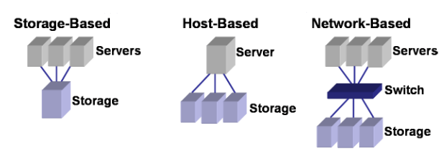
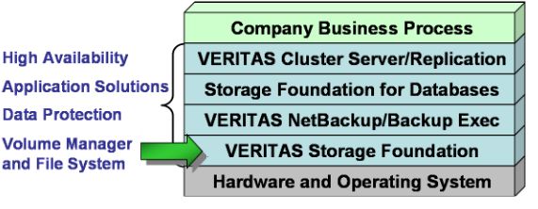
Fundamentals - Introduction
Storage management Issues
What is Storage Virtualization?
Process of taking multiple storage devices and combining them into logical virtual devices that present to the OS, application and users.
Storage Virtualization Types
Veritas Storage Foundation
Performance
Availability
Manageability

Slide 4
Fundamentals - Introduction
Veritas Storage Foundation – Release versions
Features
Storage Foundation Manager
Dymanic Storage Tiering
Portable Data Containers
Dynamic Multipathing
FlashShap
Veritas Volume Replicator
Online Relayout
Hot-Reallocation
Faster Startup Time
File level SmartSync (FastResync)
Veritas Volume Manager 6.0 - December 2011
Veritas Volume Manager 5.1 - August 2008
Veritas Volume Manager 5.0 - January 2007
Veritas Volume Manager 4.1 - April 2005
Veritas Volume Manager 4.0 - February 2004
Veritas Volume Manager 3.5 - September 2002
Veritas Volume Manager 3.2 - August 2000
Veritas Volume Manager 3.0
Creating a volume of maximum size (Specify the “vxassist make” command with the maxsize keyword)
Veritas Volume Manager co-existence with Oracle Automatic Storage Management (ASM) disks
Migrating a source file system to the VxFS file system over NFS v3
Support for product installation using yum on Linux
Support for product deployment using Flash Archives on Solaris 10
4

Slide 5
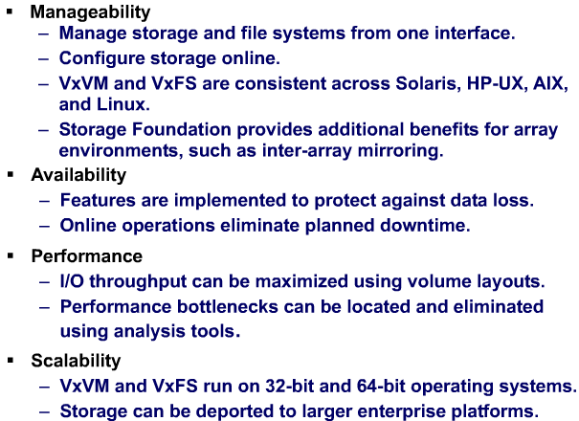
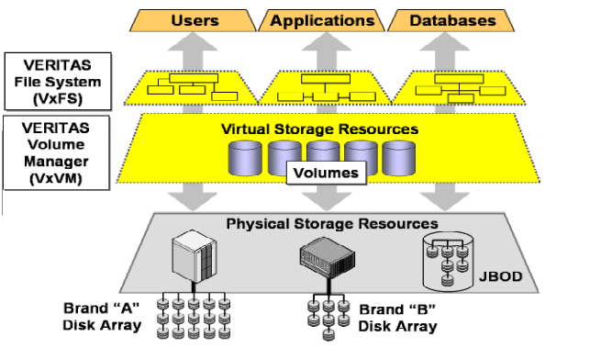
Fundamentals - Introduction
VxVM & VxFS
Benefits

Slide 6
Fundamentals – Virtual Objects
Physical Data Storage
Virtual Data Storage
Volume Manager Storage Objects
Volume Manager RAID Levels

Slide 7
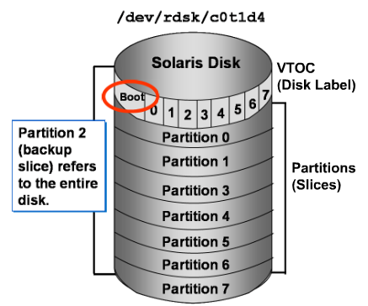
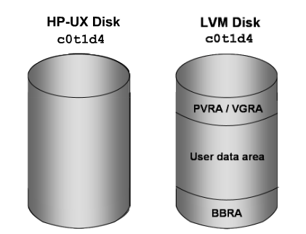
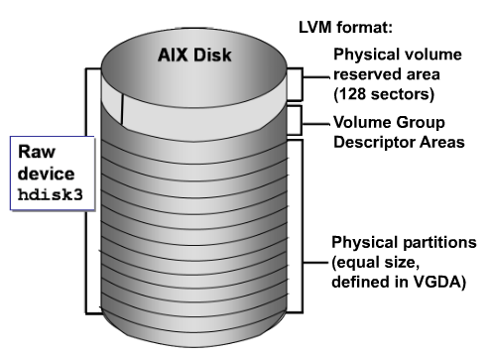
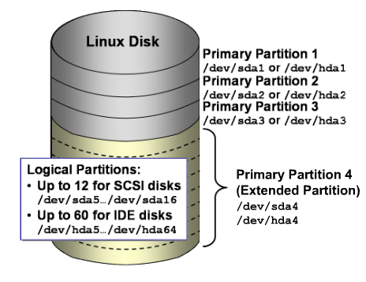
Fundamentals – Virtual Objects – Physical Data Storage
Physical Storage Objects

Slide 8
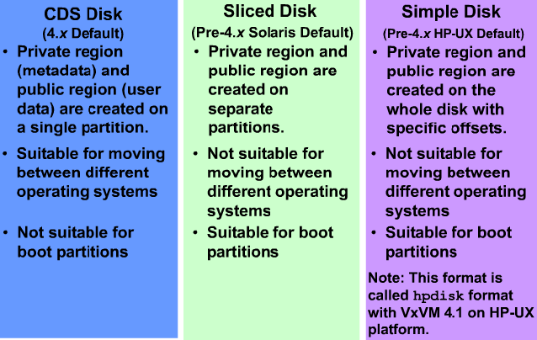
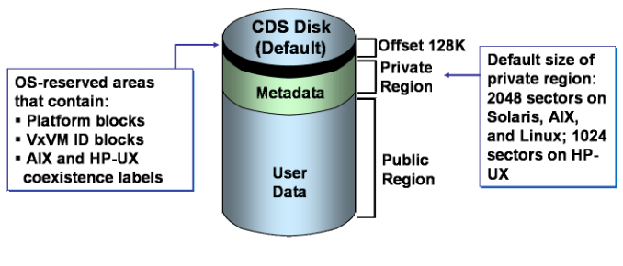

Fundamentals – Virtual Objects – Virtual Data Storage
Online administration
Multi disk configuration
High Availability
Load Balancing
Data Spanning

Slide 9
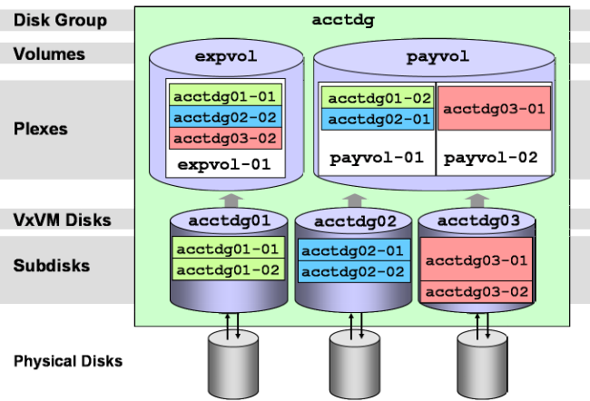
Fundamentals – Virtual Objects – Virtual Manager Storage Objects

Slide 10
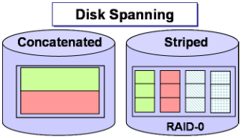
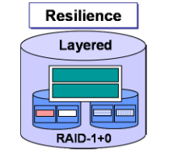
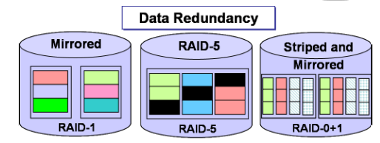
Fundamentals – Virtual Objects – Virtual Manager RAID Levels

Slide 11
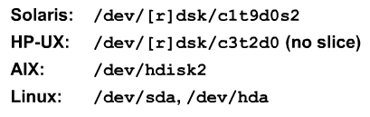
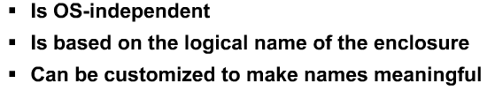
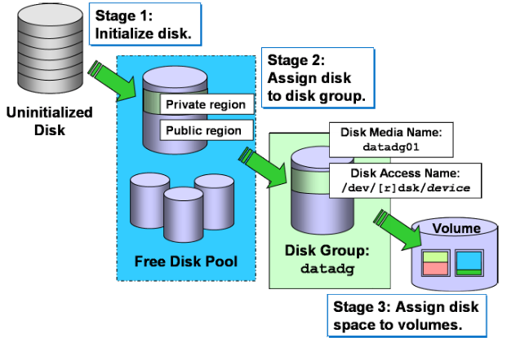
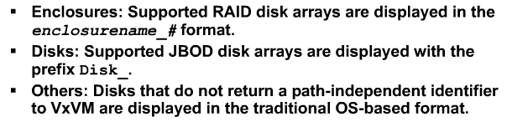
Fundamentals – Managing Disks & Disk Groups
Naming Disk Devices
System Wide Reserved Disk Groups
Traditional device naming
bootdg
defaultdg
nodg
Enclosure based naming
Disk Configuration Stages
Creating disk group
Initializing disk
Viewing disk groups
Evacuating a disk
Removing a disk
Renaming a disk

Slide 12
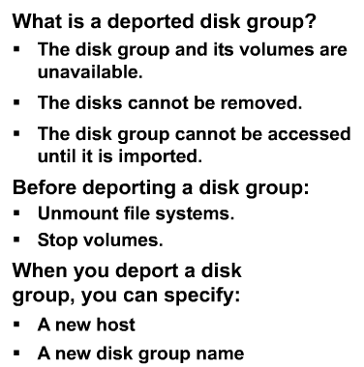
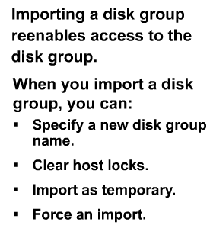
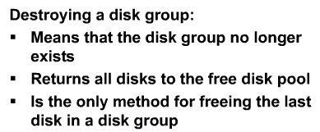
Fundamentals – Managing Disks & Disk Groups
Deporting disk group
Importing disk group
Moving disk group
Destroying disk group

Slide 13
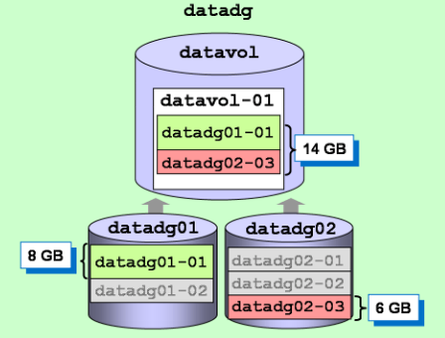
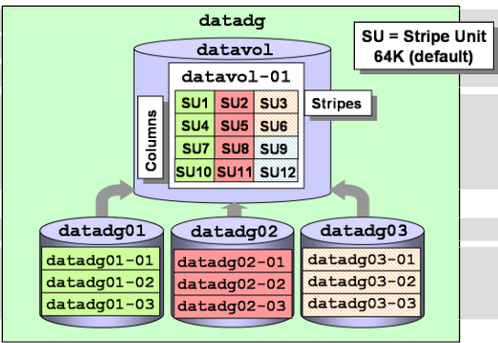
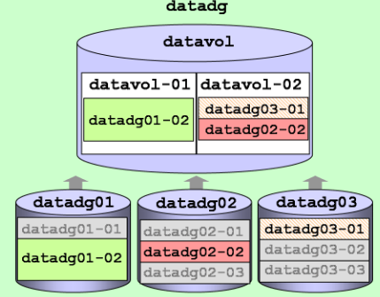
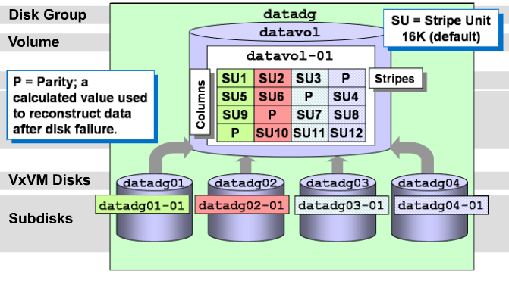
Fundamentals – Creating Volumes – Volume Layouts
Concatenated Layout
Striped Layout
Mirrored Layout
RAID-5 Layout

Slide 14
Fundamentals – Creating Volumes – Volume Layouts
Mirrored-Stripe
A volume that is configured as a striped plex and another plex that mirrors the striped one. This requires at least two disks for striping and one or more other disks for mirroring (depending on whether the plex is simple or striped). The advantages of this layout are increased performance by spreading data across multiple disks and redundancy of data
Layered Volume
A volume constructed from other volumes. Non-layered volumes are constructed by mapping their subdisks to VM disks. Layered volumes are constructed by mapping their subdisks to underlying volumes (known as storage volumes), and allow the creation of more complex forms of logical layout
A striped-mirror volume is created by configuring several mirrored volumes as the columns of a striped volume. This layout offers the same benefits as a non-layered mirrored-stripe volume. In addition it provides faster recovery as the failure of single disk does not force an entire striped plex offline.
A concatenated-mirror volume is created by concatenating several mirrored volumes. This provides faster recovery as the failure of a single disk does not force the entire mirror offline

Slide 15
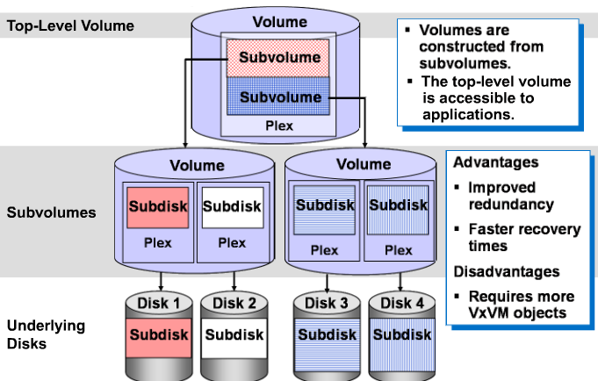
Fundamentals – Creating Volumes – Volume Layouts
Layered Volumes

Slide 16
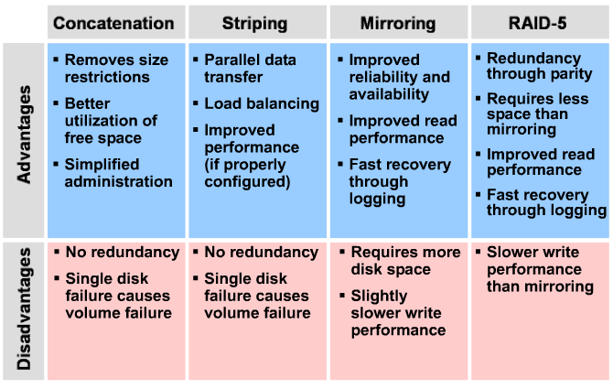
Fundamentals – Creating Volumes – Volume Layouts
Comparing Volume Layouts
DRL – Dirty Region Logging
Log subdisks are defined and added to a plex that is to become part of a volume on which dirty region logging (DRL) is enabled. DRL is enabled for a volume when the volume is mirrored and has at least one log subdisk. Only one log subdisk can be associated with a plex. Because this log subdisk is frequently written, care should be taken to position it on a disk that is not heavily used. Placing a log subdisk on a heavily-used disk can degrade system performance.

Slide 17
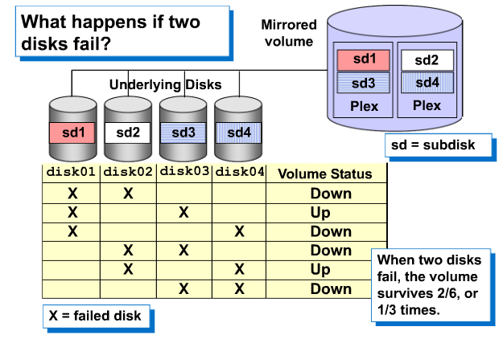
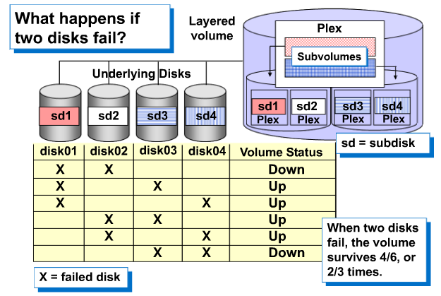
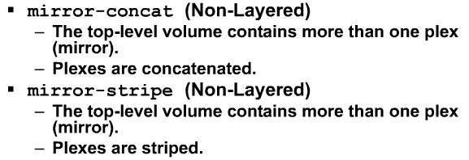
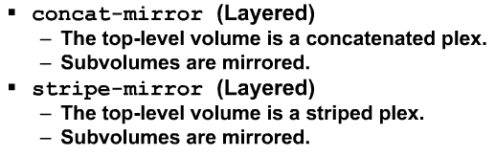
Fundamentals – Creating Volumes – Volume Layouts
Mirrored Volume
Striped-Mirror
4 types of Mirroring

Slide 18
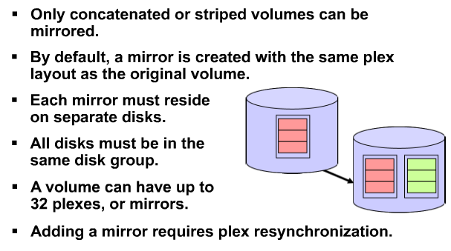
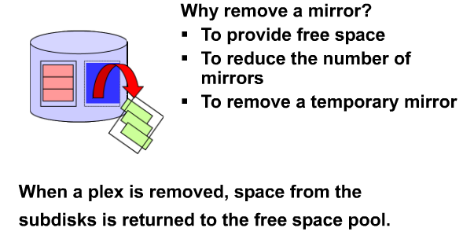
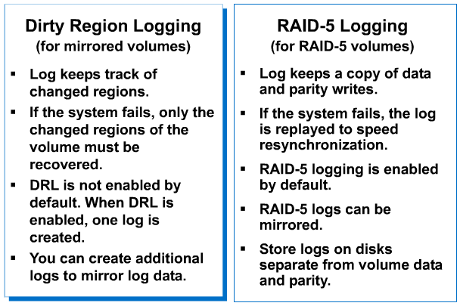
Fundamentals – Configuring Volumes
Adding a Mirror to Volume
Removing a Mirror
DRL vs RAID-5

Slide 19
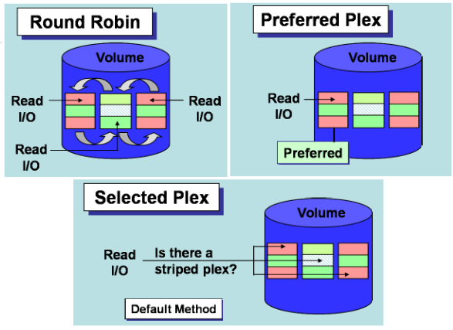
Fundamentals – Configuring Volumes – Volume Read Policies

Slide 20
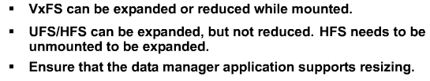
Fundamentals – Configuring Volumes – Resizing Volumes
vxresize -> Both volume & file system
vxassist -> Volume Only
fdadm -> File system only

Slide 21
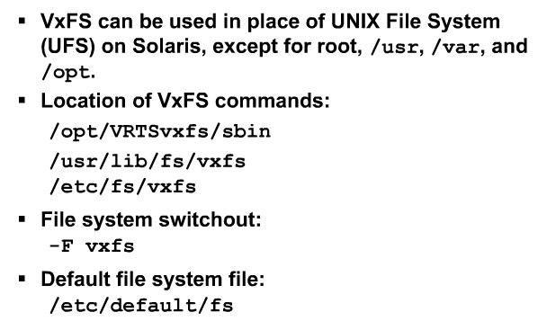
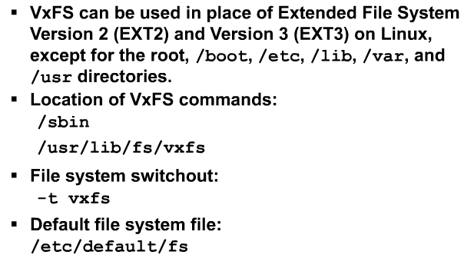
Fundamentals – Administering File Systems

